Slide 1


Extraction and Access to Information in Natural Language for Non-Developers - Democratizing Information
Emanuel Matos
Progress 2019/2020

Slide 2
Overview
Introduction
Developments
Dataset
BERT
Results
Future Work
Worplan Update

Slide 3
INTRODUCTION
Automatic extraction of information from natural language sources has many applications, including Business Intelligence ,Forensics, Medicine, and question answering systems . Despite their potential, creation of such systems for new domains is not simple and, in general, development has been limited to developers with in-depth knowledge of the area. As extraction methods improve, the amount of information also augments, making more and more difficult effective access by humans.
With this scenario in mind, our initial proposal also considers the development of an easy to use application to access the information alongside the evolution of the State of the Art in Open Information Extraction. The easy to use application to access information in key for the democratization of the access to knowledge. Within what we were expected to accomplish, we succeeded in the vast majority of points.
But we have to put as a background some situations that led us to slow down the speed of both production and research. The COVID-19 that got more severe than expected, my return to Brazil due to family problems, my livelihood (full time job), all these items led me to reduce my working time. The main objective of the PhD is to investigate new methodologies that allow the democratization of the exploitation of information on any basis in an environment focused on Tourism.

Slide 4
Developments
Beginning of the assembly of the annotation automation process, based on the premises that we listed in the definition in the work of the pre-thesis. In parallel we started structuring some NER’s that would be part of the initial scope, more precisely we adjusted the Linguakit as the first NER to be used.
Nov/Dec
Nov and Dec/2020 we identified the next NER, with the2 systems adjusted to work in Windows, was created based in Python to optimize the scripts which generate and store results, still in a phase of Proof of Concept. Working at the junction of these 2 NER’s we have already visualized the need for a third NER for ”tiebreaker”.
Jan/Feb
Jan/2021,we put Dbpedia to work, Feb/2021, with the 3 NER’s running on separate data, we started what we call debugging the basic pipeline
Mar/Apr
Mar/2021 we identified and started the process of extraction and cleaninng data of our Dataset, April until the end of June 2021 we align the pipeline with 2 forms of decision the WTA (Winner Takes All) and what created ENTITY, regardless of its basic characteristics, with the data we performed the tests and writing of the Paper that we published in Jul/2021.
May/Aug
In August/2021 we started the tests with a new NER, BERT and we are still working on a dataset , now already work with HAREM dataset in order to compare the results obtained in the processing s via generated Pipeline. We will explain the results in BERT and concatenate the harem-based om.

Slide 5
State-of-the-art update
In the search to know NER or processes that would lead us to create NER in the state of the art, considering the mentioned two main types , the most relevant approaches are:
Rule-based NER – covering both systems based in patterns and in lists (the so called Gazetteers).
NERs using Machine learning – Machine learning methods are more flexible to adapt to distinct contexts provided that exists enough data about the target context. Diverse machine learning methods have been applied to NER. They can be categorized in three main branches that have distinct needs of training data: supervised learning, unsupervised learning and reinforcement learning

Slide 6
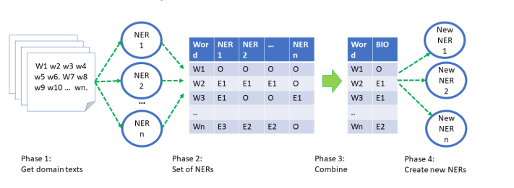
Ensamble NERs
Named Entity Recognition (NER) is an essential step for many natural language processing tasks, including Information Extraction. Despite recent advances, particularly using deep learning techniques, the creation of accurate named entity recognizers continues a complex task, highly dependent on annotated data availability. To foster existence of NER systems for new domains it is crucial to obtain the required large volumes of annotated data with low or no manual labor.
Notes:
Build up an App based in Open IE for Tourism.

Slide 7
Dataset(s) for Tourism Domain
For an initial proof-of-concept related to tourism were selected.
A set of sources were selected manually, and the text scrapped using the Scrapy library for retrieving documents and BeautifulSoup library for getting document data.
One of the main sources selected was Wikivoyage ,with more than 300 texts of places / cities / tourist points.
Notes:
Build up an App based in Open IE for Tourism.

Slide 8
BERT-based NER trained with automatically annotated data
Aiming to mitigate the problems highlighted above, the following main objectives were adopted for the work presented:
1. Develop processes to simplify the creation of NER systems for new domains, starting by the creation of the needed annotated data;
2. Make NER deployment as easy as possible in order to used by non specialists, contributing to breaking existing usage barriers thus fostering wider adoption of such systems.
Notes:
Build up an App based in Open IE for Tourism.

Slide 9
Results
The initial results obtained with the proposed system, starting with representative examples of obtained annotations based on combining the output of the 3 NERs.
Published
Based in our previous work was be possible a publication in SLATE-July 2021 with title ” Towards Automatic Creation of Annotations to Foster Development of Named Entity Recognizers” . Emanuel Matos, Mario Rodrigues, Pedro ´ Miguel, Antonio J. S. Teixeira.
In preparation
Exist a continued research been prepared to apply for PROPOR 2022, this develop will be focus in comparing results with dataset HAREM and shows an amazing possibilities with a base created with automatic annotate.
Software
We also started the development of the software “Tools for non-programmers”
Notes:
Build up an App based in Open IE for Tourism.

Slide 10
Future work
Our goal continues to be the creation of “Tools for non-programmers” . These software tools will combine parts already created with others not yet develop (ex: CAIT). To advance towards our goal the next steps are essential:
• Improve the NERs integrating the Ensemble: Particularly improving the performance of DBpedia-based NER, both in augmenting its speed (ex: with a local Virtuoso server) and improving the decision of Tags to keep from the DBpedia query results. Also the exploration of translation to increase the number of entities annotated has been started.
• Addition of NERs to the Ensemble: Add other NERs to the ensemble: For example, specialized NERs for specific classes (ex: time) or using other sources of information (ex: YAGO and Wikipedia) and ontologies.
• Use tagged data to train NERs: Continue and extend the work on training ML systems, starting with a NER based on BERT [16] ENTITY/NOENTITY tagging. • Improve the process of NERs output combination.
• Test the system in new domains.
Notes:
Build up an App based in Open IE for Tourism.

Slide 11
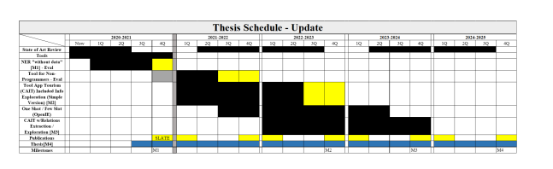
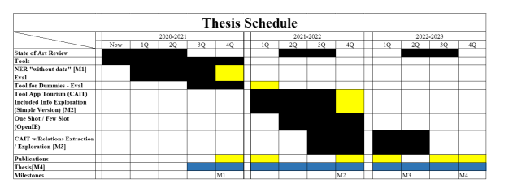
Workplan Update
Milestones - Update Each Milestone refers to a delivery and then will be necessary an update too , next the product or report as follows:
• M1 - which is the 1st milestone is like the delivery of the “NER without data registration”, this delivery will take place at the end of the 1st year, that is, until 20/21 Sep. - OK.
• M2 - will be the delivery of the CAIT App in a simpler version around 4Q on 21/22 22/23.
• M3 - Will already be the delivery of CAIT in a version with Exploration of other relationships within the domain in 2Q to 22/23 4Q to 23/24.
• M4 - must be the delivery of the document with the details of how the App was developed, the technology shipped and the results obtained the delivery will be in September 2023 September 2025

